Slide 1

Analysis of food
and
Beverage Industry using Power bi
Present by-Tushar Darmwal
BATCH NAME-MIP-DA-13

Slide 2
Datasets
City_id
City
Tier
Respondent_ID
Name
Age
Gender
City_ID
Response_ID
Consume_frequency
Consume_time
Consume_reason
Heard_before
Brand_perception
General_perception
Tried_before
Taste_experience
Reason_preventing_trying
Current_brands
Reasons_for_choosing_brands
Improvements_desired
Ingredients_expected
Health_concerns
Interest_in_natural_or_organic
Marketing_channels
Packaging_preference
Limited_edition_packaging
Price_range
Purchase_location
Typical_consumption_situations

Slide 3
Steps involved in Data Transformation
1.Remove Duplicates
2.Remove Errors
3.Change type
4.Promoted headers

Slide 4
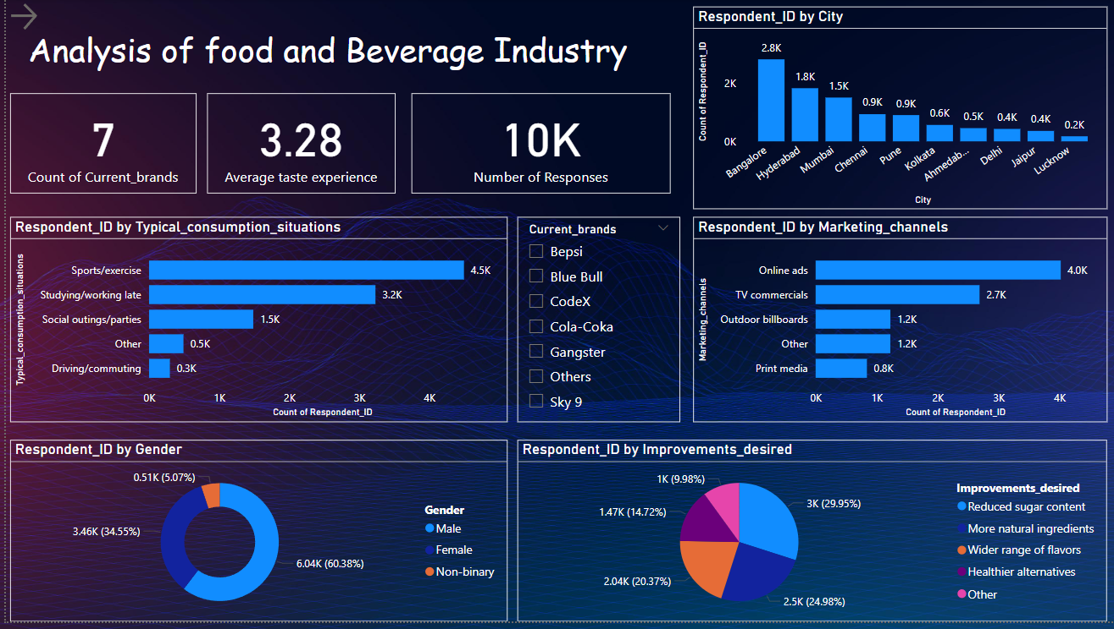
DASHBOARD

Slide 5
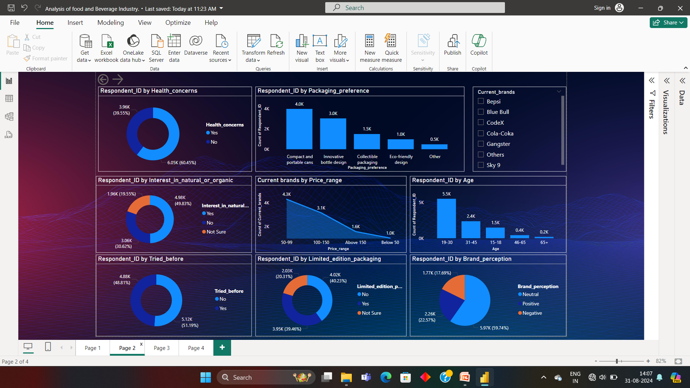

Slide 6
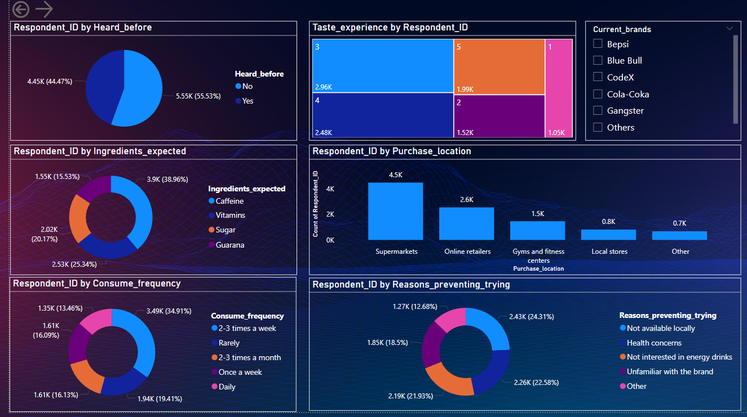

Slide 7
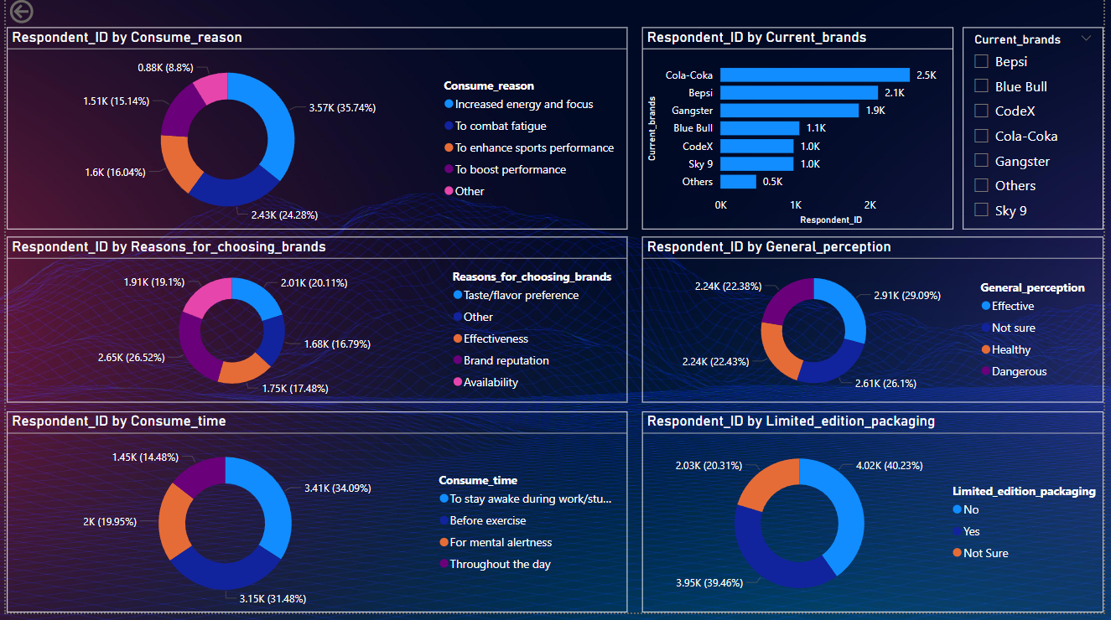

Slide 8
Insights
Most number of respondents are from Bengalore and lowest are from Lucknow.
49.83% of respondents are interested in natural or organic products and 30.62% are not interested in natural or organic products and 19.55% are not sure about it.
Most respondents improvement desired is to reduce suger content .
Most number of respondents are between age of 19-30 and lowest are of 65+.
Most respondents wants Compact and portable cans as packaging preference.
Respondents mostly use products at the time of sports/exercise.
40.23% of respondents don’t want limited edition packaging and 39.46% of respondents wants limited edition packaging and 20.31% respondents are not sure about it.
Products are consumed mostly 2-3 times a week by respondents.
Caffeine ingredient expected is most by the respondents.
Most number of reason for choosing brand by respondents is Taste/flavour.
55.53% of respondents have heard before about our brands and 44.47% respondents haven’t heard about our brands before (Gangster brand is most heard before brand among all brands).
Most number of respondents purchase from supermarkets.
Online ads is mostly choosen by the respondents.
51.19% of respondents have tried before our brands and 48.81% of respondents haven’t tried our brand before (Cola coka brand is most tried brand before by respondents among all brands ).

Slide 9
Most brands are of price range between Rs 50-99.
Most respondents consume reason is to increase energy and focus.
Cola-coka is the most choosen brand by respondents.
Most number of reasons selected by respondents for preventing trying of brands is not available locally.
Consume time for most respondents is to stay awake during work/study.
Average taste experience for respondents is 3.28.
60.45% of respondents are health concern and 39.55% of respondents are not health concern.
59.74% respondents have neutral brand perception and 22.57% have positive and 17.69% have negative brand perception.
29.09% have effective general perception and 26.1 % are not sure about it and 22.43% have healthy general perception and 22.38% have dangerious general perception.

Slide 10
THANK YOU

